Slide 1
BU 8201 TUTORIAL 3
Group 8
Ang Hui Xin
Loo Yun Hann Augustine
Hpu Pwint Wathan
Lim Kah Yeow

Slide 2

Recap

Slide 3

What is a bond?
A long term debt instrument
2 different kinds of bond:
1) Zero coupon bond (no periodic interest)
2) Coupon bond (pays periodic interest)

Slide 4
Key features of the bond
Fixed
Not fixed
Par value
Coupon interest rate
Maturity date
Payment frequency
Price of the bond
Yield to maturity
→Lower Price: Higher YTM
→Higher Price: Lower YTM

Slide 5

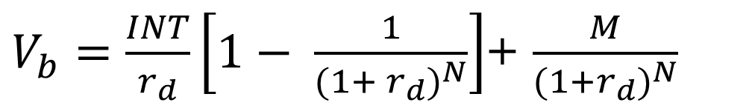

Annual bond value
$V_{b}=\frac{INT}{r_{d}}\left[1− \frac{1}{{(1+ r_{d})}^{N}}\right]$+ $\frac{M}{{(1+r_{d})}^{N}}$
INT - Coupon Rate X Par Value
M - Par Value
$r_{d}$ - Yield-to-Maturity (Annual Rate)
N - Period

Slide 6
YTM & INT
Yield-To-Maturity (YTM)
Annual Coupon Rate (INT)
Represents current or prevailing rates
Fixed for given bond and does not change
Represents the rate at time of issue
→When Bond Price = Par, YTM = Coupon Rate
→When YTM < Coupon Rate, interest rate decreased
→When YTM > Coupon Rate, interest rate increased

Slide 7
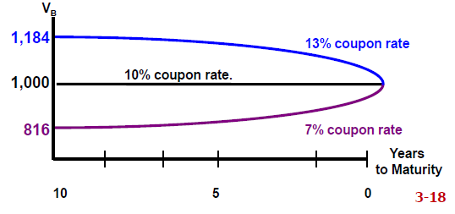
Par, Discount and Premium Bond
Par bond
YTM = Coupon Rate
Bond Price = Par Value
Discount Bond
YTM > Coupon Rate
Bond Price < Par Value
Premium Bond
YTM < Coupon Rate
Bond Price > Par Value

Slide 8
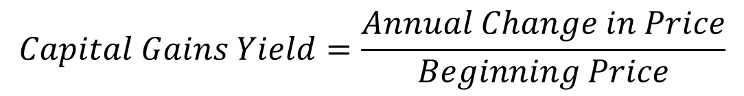
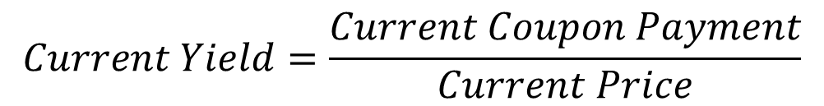

Components of YTM
Current Yield (CY)
Capital Gains Yield (CGY)
Expected total return (YTM)
$$Current Yield=\frac{Current Coupon Payment}{Current Price}$$
$$Capital Gains Yield=\frac{Annual Change in Price}{Beginning Price}$$
$$YTM=CY+CGY$$

Slide 9
Realized Return VS YTM
Holding the bond to maturity, one earns YTM
Holding the bond for a period of time and selling it off, one earns Realized Yield or Realized Return
Rates fall, Realized Return > YTM
Rates rise, Realized Return < YTM

Slide 10
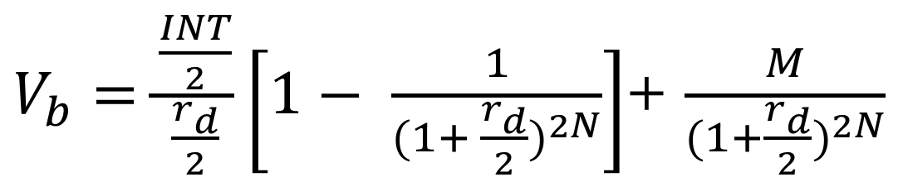
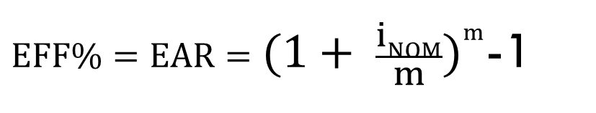
Semi – Annual Bond Value
Bond coupon payment, twice a year
EFF formula
$V_{b}=\frac{\frac{INT}{2}}{\frac{r_{d}}{2}}\left[1− \frac{1}{{(1+ \frac{r_{d}}{2})}^{2N}}\right]$+ $\frac{M}{{(1+\frac{r_{d}}{2})}^{2N}}$
$EFF\%=EAR={(1+ \frac{iNOM}{m})}^{m}$-1

Slide 11
Callable bond (I)
Bond with call feature
Allows issuer to buy back the bond
Pre-specified price > par value
Usually when interest rates decline
Issuer can re-borrow at lower rates

Slide 12
Callable bond (II)
Lenders will require higher interest rate for callable bond
Deferred call (delay for a period first) and declining call premium

Slide 13
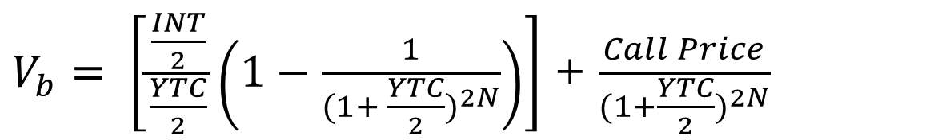
Yield To Call
Bond Price
Return to bondholder who buys bond at today’s price and is forced to sell bond at Call Price on Call Date
Premium bond - YTC < YTM
$V_{b}= \left[\frac{\frac{INT}{2}}{\frac{YTC}{2}}\left(1−\frac{1}{(1+ \frac{YTC}{2})^{2N}}\right)\right]$ + $\frac{Call Price}{(1+\frac{YTC}{2})^{2N}}$

Slide 14
Risks Of Bond
Interest Rate Risk (Price Risk)
- Longer bond has higher risk
Reinvestment Rate Risk
- Higher for short-term bond
Default or Credit Risk
- Influenced by the issuer’s financial strength
and the terms of the bond contract

Slide 15

Tutorial Questions

Slide 16
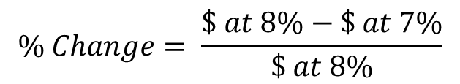
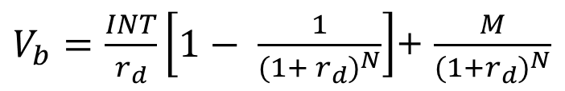
Question P9-7
$V_{b}=\frac{INT}{r_{d}}\left[1− \frac{1}{{(1+ r_{d})}^{N}}\right]$+ $\frac{M}{{(1+r_{d})}^{N}}$
$$\% Change= \frac{\$ at 8\%−\$ at 7\%}{\$ at 8\%}$$
Par Value = $1000
 | Price at 8% | Price at 7% | % Change
10-year, 10% annual coupon | $1134.20 | $1210.70 | 6.75%
10-year zero | $463.19 | $508.35 | 9.75%
5-year zero | $680.58 | $712.99 | 4.76%
30-year zero | $99.38 | $131.37 | 32.19%
$100 perpetuity | $1250.00 | $1428.57 | 14.29%

Slide 17
Question P9-7
-Comparing the % change of bonds’ price of the 5-year zero, 10-year zero and 30-year zero bonds, it is shown that as the bonds' maturity period increases, the % change of the bonds' price increases.
-This proves that long-term bonds are more sensitive to interest rate changes than short term bonds, increasing interest rate risks.
-In fact, the increase in % change of bonds’ prices more than doubles when comparing 5-year zero to 10-year zero, and more than triples when comparing 10-year zero and 30-year zero bonds.

Slide 18
Question P9-7
-Comparing the % change in bonds’ prices of the 10-year, 10% coupon rate bond and the $100 perpetuity bond reaps the same results – that as the length to maturity increases, the more sensitive the bond is to interest rate changes

Slide 19
Question P9-7
-The 10-year zero has a higher % change in bond’s price than that with a 10% coupon rate, despite having the same maturity period.
This proves that bonds with a coupon rate are less sensitive to interest rate changes, reducing interest rate risks.

Slide 20
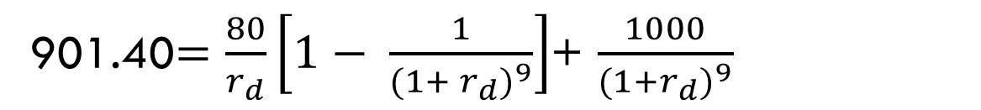
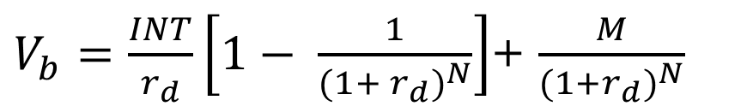

Question P9-10
a)
$V_{b}=\frac{INT}{r_{d}}\left[1− \frac{1}{{(1+ r_{d})}^{N}}\right]$+ $\frac{M}{{(1+r_{d})}^{N}}$
901.40$=\frac{80}{r_{d}}\left[1− \frac{1}{{(1+ r_{d})}^{9}}\right]$+ $\frac{1000}{{(1+r_{d})}^{9}}$
$$r_{d}=9.69\%$$
Inputs | 9 |  | -901.40 | 80 | 1000
 | N | I/YR | PV | PMT | FV
Output |  | 9.69

Slide 21
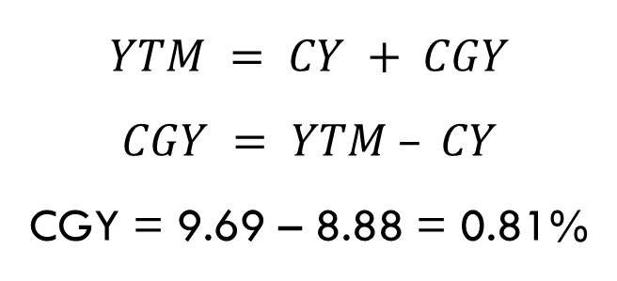
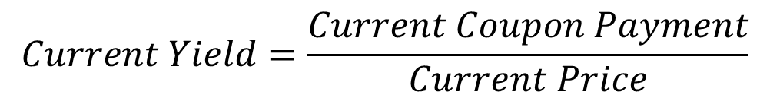
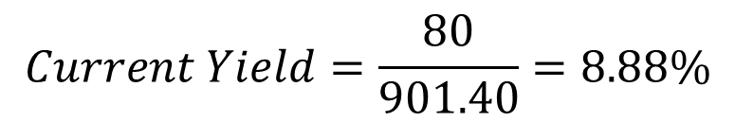
Question P9-10
b)
$$Current Yield=\frac{Current Coupon Payment}{Current Price}$$
$$Current Yield=\frac{80}{901.40}=8.88\%$$
$$YTM = CY + CGY$$
$$CGY = YTM – CY$$
CGY = 9.69 – 8.88 = 0.81%

Slide 22
Question P9-10
C)
No.
As interest rate falls, the price of bonds increases. This provides investors with a higher realized yield if they sold the bond, thus Realized Yield > YTM
As interest rate increases, the price of bonds decreases. This provides investors with a lower realized yield if they sold the bond, thus Realized Yield < YTM

Slide 23
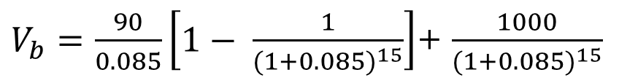
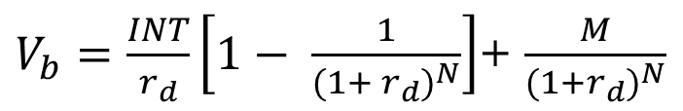
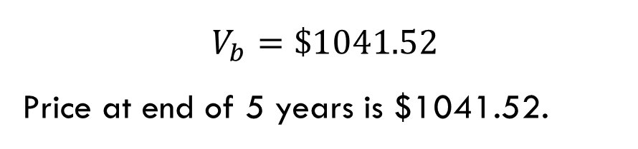
Question P9-15
$V_{b}=\frac{INT}{r_{d}}\left[1− \frac{1}{{(1+ r_{d})}^{N}}\right]$+ $\frac{M}{{(1+r_{d})}^{N}}$
$V_{b}=\frac{90}{0.085}\left[1− \frac{1}{{(1+0.085)}^{15}}\right]$+ $\frac{1000}{{(1+0.085)}^{15}}$
$$V_{b}=\$1041.52$$
Price at end of 5 years is $1041.52.
Inputs | 15 | 8.5 |  | 90 | 1000
 | N | I/YR | PV | PMT | FV
Output |  |  | -1041.52

Slide 24
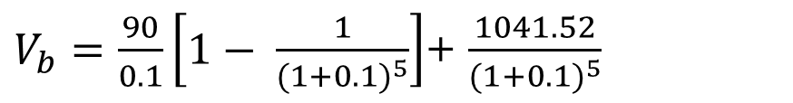
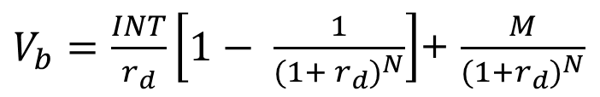

Question P9-15
$V_{b}=\frac{INT}{r_{d}}\left[1− \frac{1}{{(1+ r_{d})}^{N}}\right]$+ $\frac{M}{{(1+r_{d})}^{N}}$
$V_{b}=\frac{90}{0.1}\left[1− \frac{1}{{(1+0.1)}^{5}}\right]$+ $\frac{1041.52}{{(1+0.1)}^{5}}$
$$V_{b}=\$987.87$$
I am willing to pay $987.87 for Bond X today.
Inputs | 5 | 10 |  | 90 | 1041.52
 | N | I/YR | PV | PMT | FV
Output |  |  | -987.87

Slide 25
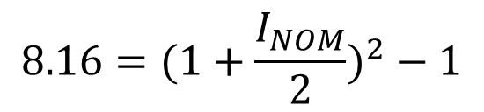
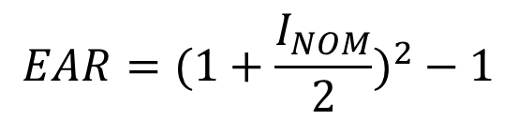

Question P-16
$$EAR=(1+\frac{I_{NOM}}{2})^{2}−1$$
$$8.16=(1+\frac{I_{NOM}}{2})^{2}−1$$
$$I_{NOM}=8\%$$

Slide 26
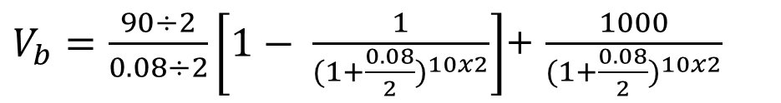
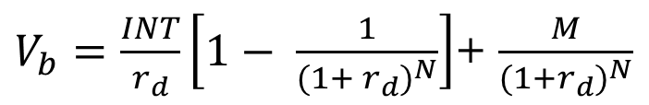

Question P-16
$V_{b}=\frac{INT}{r_{d}}\left[1− \frac{1}{{(1+ r_{d})}^{N}}\right]$+ $\frac{M}{{(1+r_{d})}^{N}}$
$V_{b}=\frac{90÷2}{0.08÷2}\left[1− \frac{1}{(1+\frac{0.08}{2})^{10x2}}\right]$+ $\frac{1000}{{(1+\frac{0.08}{2})}^{10x2}}$
$$V_{b}=1067.95$$
Inputs | 20 | 4 |  | 45 | 1000
 | N | I/YR | PV | PMT | FV
Output |  |  | -1067.95

Slide 27
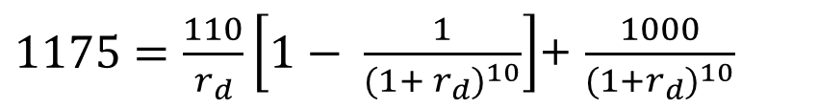
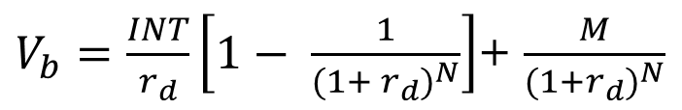

Question P-19
a)
$V_{b}=\frac{INT}{r_{d}}\left[1− \frac{1}{{(1+ r_{d})}^{N}}\right]$+ $\frac{M}{{(1+r_{d})}^{N}}$
$1175=\frac{110}{r_{d}}\left[1− \frac{1}{{(1+ r_{d})}^{10}}\right]$+ $\frac{1000}{{(1+r_{d})}^{10}}$
$$r_{d}=8.3506\%$$
Inputs | 10 |  | 1175 | 110 | 1000
 | N | I/YR | PV | PMT | FV
Output |  | 8.3506

Slide 28
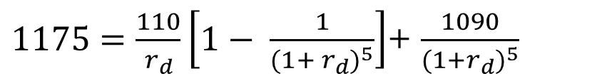
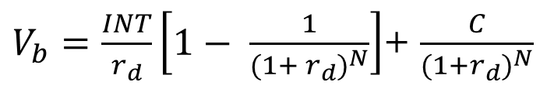

Question P-19
b)
$V_{b}=\frac{INT}{r_{d}}\left[1− \frac{1}{{(1+ r_{d})}^{N}}\right]$+ $\frac{C}{{(1+r_{d})}^{N}}$
$1175=\frac{110}{r_{d}}\left[1− \frac{1}{{(1+ r_{d})}^{5}}\right]$+ $\frac{1090}{{(1+r_{d})}^{5}}$
$$r_{d}=8.1319\%$$
Inputs | 5 |  | 1175 | 110 | 1090
 | N | I/YR | PV | PMT | FV
Output |  | 8.1319

Slide 29
Question P-19
YTC instead of YTM.
If the interest rate is the same and the bond is sold at premium, the market rates have fallen, thus the investor will prefer YTC more.

Slide 30
Question P-19
d) Condition for call for premium is YTC < YTM
→ 6th year: YTC = 8.26%
→ 7th year: YTC = 8.37% (> 8.35%)
→ 8th year: YTC = 8.4566% (> 8.35%)
→ 9th year: YTC= 8.5284% (> 8.35%)
Since YTC > YTM from the 7th year onwards, the latest that the firms will be expected to call the bonds will be the 6th year.

Slide 31
Thank You ☺
Thank You ☺

